Slide 1
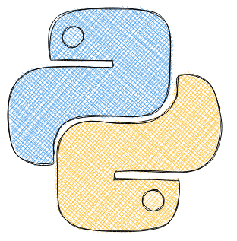
Data Science overview and Introduction to Python (Part I)
Week1
Conditions and Loops
Middlesex University Dubai: Winter22
CST4050; Instructor: Dr. Ivan Reznikov

Slide 2

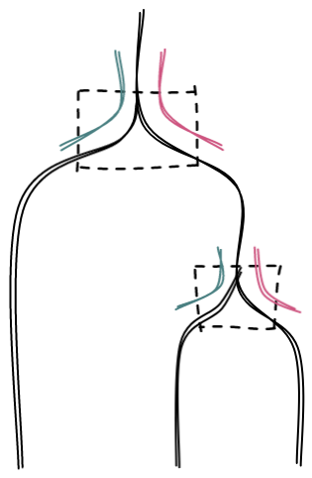

Conditions and Logic
if True:
print('True') >>>True
if False:
print('False') >>>
if op_hand==”rock”:
print(“We won”)
else:
if op_hand==”paper”:
print(“Draw”)
else:
print(“We lost”)
my_hand = "paper"
opponents_hand = "paper"
if opponents_hand == "rock":
print("We won")
elif opponents_hand == "paper":
print("Draw") >>>Draw
else:
print("We lost")
“We won”
“Draw”
“We lost”

Slide 3
Conditions and Logic
if op_hand==”rock”:
print(“We won”)
else:
if op_hand==”rock”:
print(“We won”)
elif op_hand==”paper”:
print(“Draw”)
else:
print(“We lost”)
if op_hand==”paper”:
print(“Draw”)
else:
print(“We lost”)
“We won”
“Draw”
“We lost”

Slide 4


Conditions and Logic
Conditions and Logic
my_number = 10
if my_number > 5:
print('number greater than 5')
>>>number greater than 5
if my_number <= 8:
print('number less or equal to 8')
>>>
Equals | ==, is
Not Equals | !=, not
Less than | <
Less than or equal to | <=
Greater than | >
Greater than or equal to | >=
my_list = ['green','yellow','red']
color = 'purple'
if color in my_list:
print(f'{color} is in list')
>>>

Slide 5



Loops: for
my_value=1
my_value = 1
for i in range(3):
my_value += 2
print(my_value)
>>>7
for loop:
1)my_value+=2=>3
2)my_value+=2=>5
3)my_value+=2=>7
my_list = ['green','yellow','red']
for idx, color in enumerate(my_list):
print(idx, color) >>>0, green
>>>1, yellow
>>>2, red
print(my_value)
>>>7

Slide 6
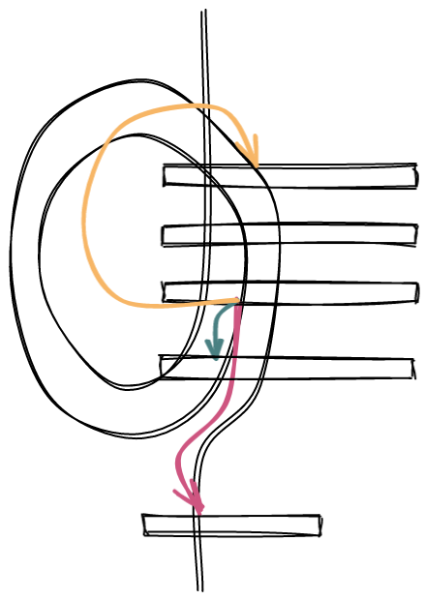
Break, pass, continue
my_val = 1
for i in range(3):
my_val += 1
if my_val == 3:
break
print("in", my_val)
print("out", my_val)
>>>in 2
>>>out 3
my_val = 1
for i in range(3):
my_val += 1
if my_val == 3:
continue
print("in", my_val)
print("out", my_val)
>>>in 2
>>>in 4
>>>out 4
(turn start)
my_val+=1
if my_val==3
print("in",my_val)
#pass
>>>in 2
>>>in 3
>>>in 4
>>>out 4
break
continue
pass
print("out",my_val)

Slide 7
For-else
my_val = 1
for i in range(3):
my_val += 1
if my_val == 3:
break
print("in", my_val)
else:
print("else")
print("out", my_val)
>>>in 2
>>>out 3
my_val = 1
for i in range(3):
my_val += 1
if my_val == 3:
pass
print("in", my_val)
else:
print("else")
print("out", my_val)
>>>in 2
>>>in 3
>>>in 4
>>>else
>>>out 4
my_val = 1
for i in range(3):
my_val += 1
if my_val == 3:
continue
print("in", my_val)
else:
print("else")
print("out", my_val)
>>>in 2
>>>in 4
>>>else
>>>out 4

Slide 8
Loops: comprehensions
temp_list = []
for x in range(10):
temp_list.append(x ** 2)
temp_list = [x ** 2 for x in range(10)]
dict1 = {'a': 1, 'b': 2, 'c': 3, 'd': 4}
double_dict1 = {}
for k,v in dict1.items():
double_dict1[k] = v*2
dict1 = {'a': 1, 'b': 2, 'c': 3, 'd': 4}
double_dict1 = {k:v*2 for (k,v) in dict1.items()}
languages = ['Java', 'Python', 'JS']
versions = [14, 3, 6]
result = zip(languages, versions)
print(list(result))
>>> [('Java', 14), ('Python', 3), ('JS', 6)]

Slide 9



Loops: while
my_value=1
For Loop
Iterate through a certain number of values
While Loop
Will just keep going until condition evaluates to False
"while loop" inside:
if my_value<=10:
my_value+=2
else:
out of loop
my_value = 1
while my_value <= 10:
my_value += 2
print(my_value) >>>11
print(my_value)
>>>11
while True: #infinite loop

